Slide 1
Water Purification Byproducts
Adding bleach fixes everything….right?

Slide 2
Byproducts
“A secondary or incidental product”
What does it mean if something is ‘incidental’? Can you think of an example of an ‘incidental’ product?

Slide 3
Byproducts form in many processes
Examples of byproducts:
Sludge from the water treatment facility
Feces from pig farming
Emissions from cars
  When gas is combusted, it turns into Nitrogen (N₂), water vapor (H₂O), Carbon Dioxide (CO₂) and other chemical compounds
CO₂ emitted when trees burn

Slide 4
Why do byproducts form?
As “waste” from a process
Through an unintended or unforeseen process
They’re formed when chemicals interact with new environments
  Highly reactive chemicals are especially likely to form byproducts
  Can you think of any highly reactive chemicals? Any that might exist in water?

Slide 5
Do byproducts form in tap water? If they do how?

Slide 6
Disinfectant Byproducts (DBP’s)
Form when chlorine disinfectants interact with naturally occurring organic material
Levels of DBP’s vary
  Depends on what types of organic matter exist in the source water
  Depends at what point during treatment disinfection occurs
  Depends how long it takes water to get to your house, and how long you store it there before you drink it
Why do you think these things effect the amount and kinds of disinfection byproducts seen in the water?

Slide 7
It’s a balance – we need disinfectants
“The risk of death from pathogens is at least 100 to 1000 times greater than the risk of cancer from disinfection by-products (DBPs) {and} the risk of illness from pathogens is at least 10 000 to 1 million times greater than the risk of cancer from DBPs [6].”

Slide 8
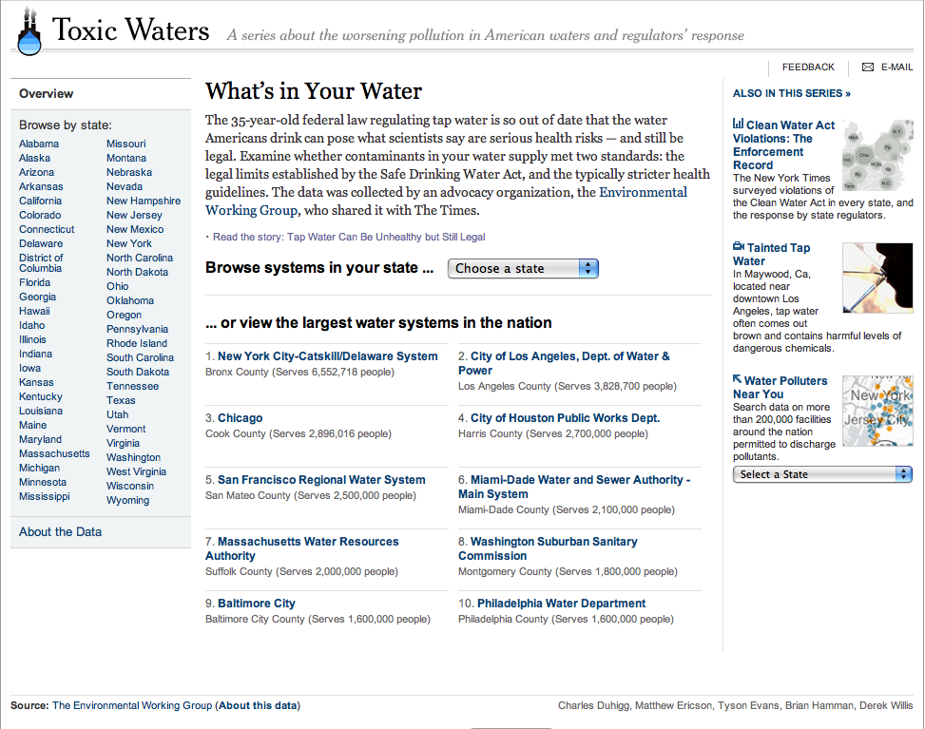
So – What’s in Our Water?

Slide 9
How do we analyze the data?
4 categories of contaminants:
Contaminants in this section were found at really high levels that are illegal
Contaminants in this section were found at levels that may be legal but are believed to be a health concern
Contaminants in this section were found at low levels that are both legal and safe
These contaminants weren’t found at all

Slide 10
Analyzing the data, continued
Questions to ask:
  When was this contaminant found?
  How often is it tested for?
  How much was actually found?
  What is it? Why should we care about it?

Slide 11
Let’s Look at the Data
New York City
Idaho Falls
Honolulu
Charlotte
Durham
Conclusions

Slide 12
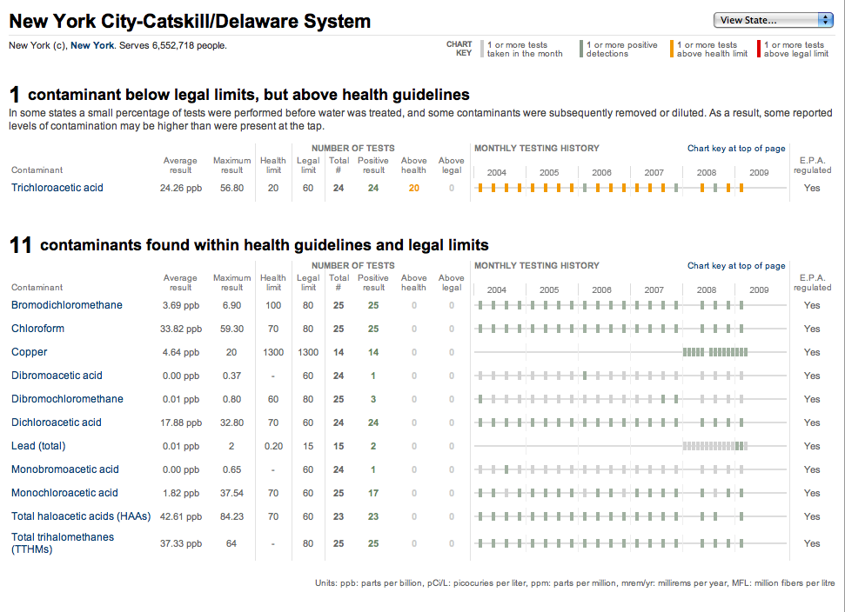
New York City
Back

Slide 13
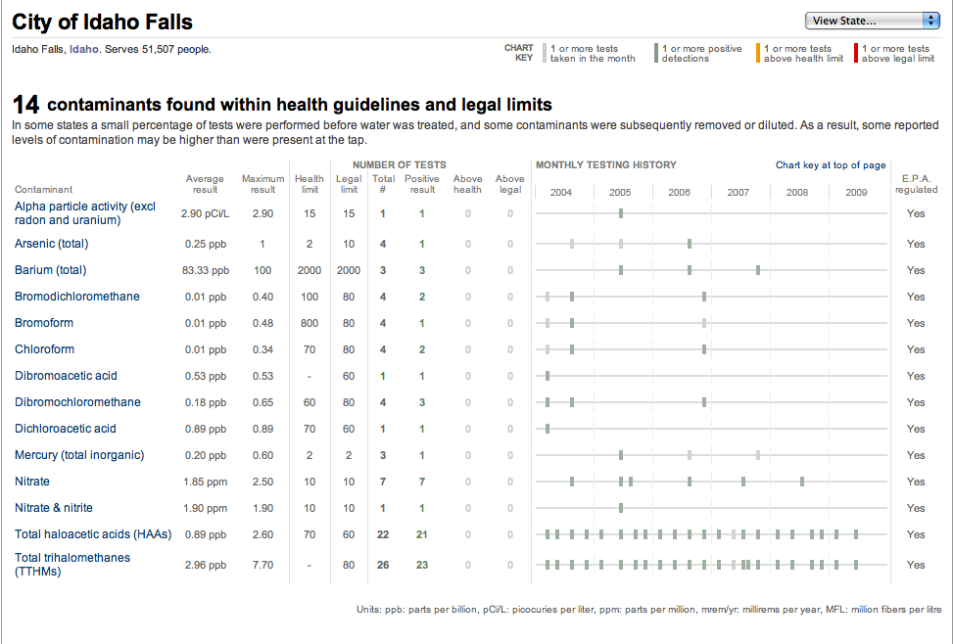
Idaho Falls
Back

Slide 14
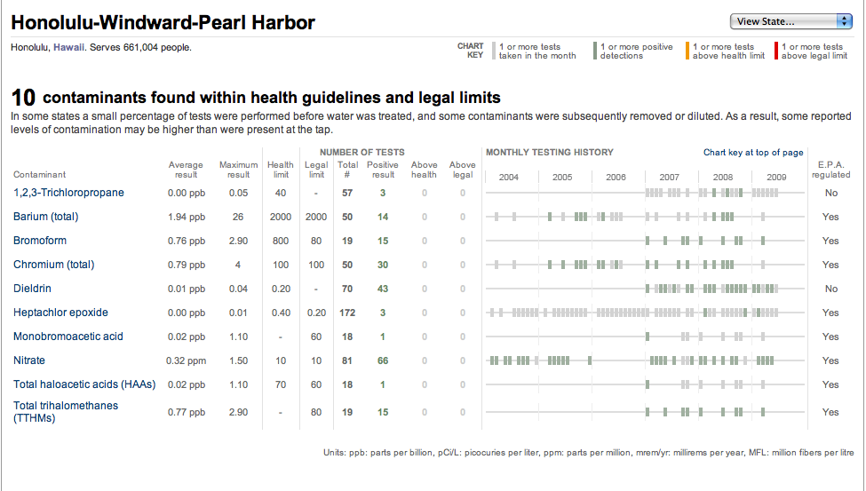
Honolulu
Back

Slide 15
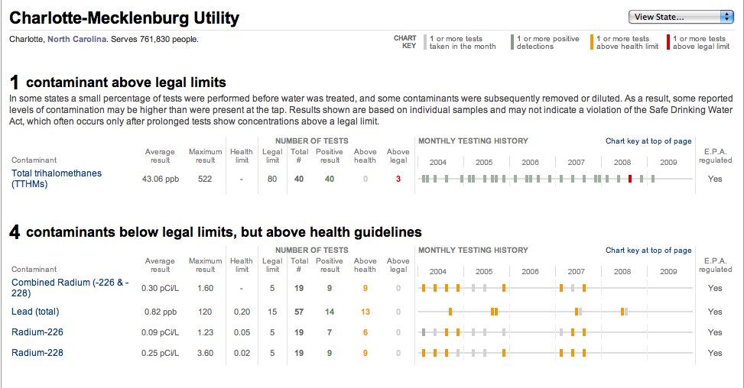
Charlotte
Back

Slide 16
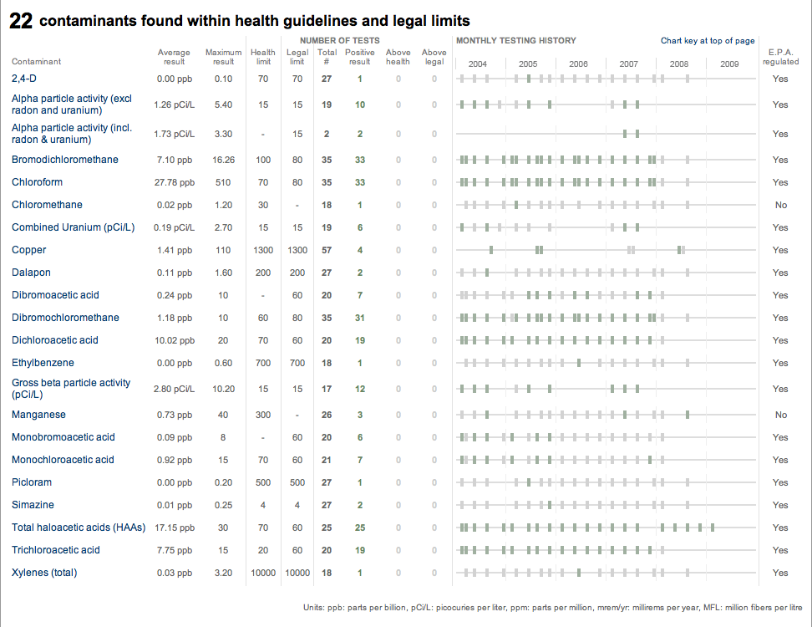
Charlotte, continued
Back

Slide 17
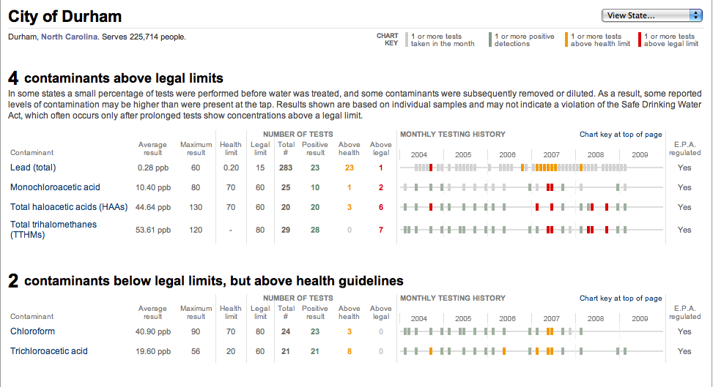
Durham
Back

Slide 18
Common Contaminants
Haloacetic Acids
  Byproducts of chlorine disinfectants
Trihalomethanes
  Byproducts of chlorine disinfectants
Lead
  Metal – from erosion of plumbing
Arsenic
  From many sources, including mining and erosion
Nitrate
  Fertilizer Runoff

Slide 19
What can the contaminants do to us?
Not much at the levels they’re present in!
  Our water is actually very safe
If they build up in our bodies or reach higher levels
  Some are toxic, some are carcinogenic
When it comes to disinfectant byproducts, we’re better off with them than without them….
  “The risk of death from pathogens is at least 100 to 1000 times greater than the risk of cancer from disinfection by-products (DBPs) {and} the risk of illness from pathogens is at least 10 000 to 1 million times greater than the risk of cancer from DBPs [6].”

Slide 20
If you have something to say about your tap water, who can you contact?

Slide 21
Our Treatment Facility
The Charlotte Area
  Via the internet, phone
Lee Dukes Treatment Plant in Huntersville
  Via the internet, phone
Check the links on your handouts to contact these facilities!

Slide 22
Our Representatives
State Senate: Malcolm Graham
  Via phone, e-mail, online
State House of Representatives: Thom Tillis
  Via phone, e-mail, online
Check the links on your handouts to contact your representatives!

